Slide 1

SCHMES MONITORING SYSTEM REPORT SECTION ULB WISE

Slide 2


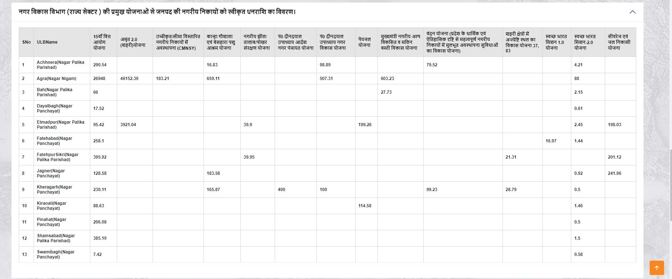
ANALYTICAL REPORT
EXPORT TO EXCEL
TOTAL ROW WISE
TOTAL COLUMN WISE FOR EACH SCHEMES

Slide 3
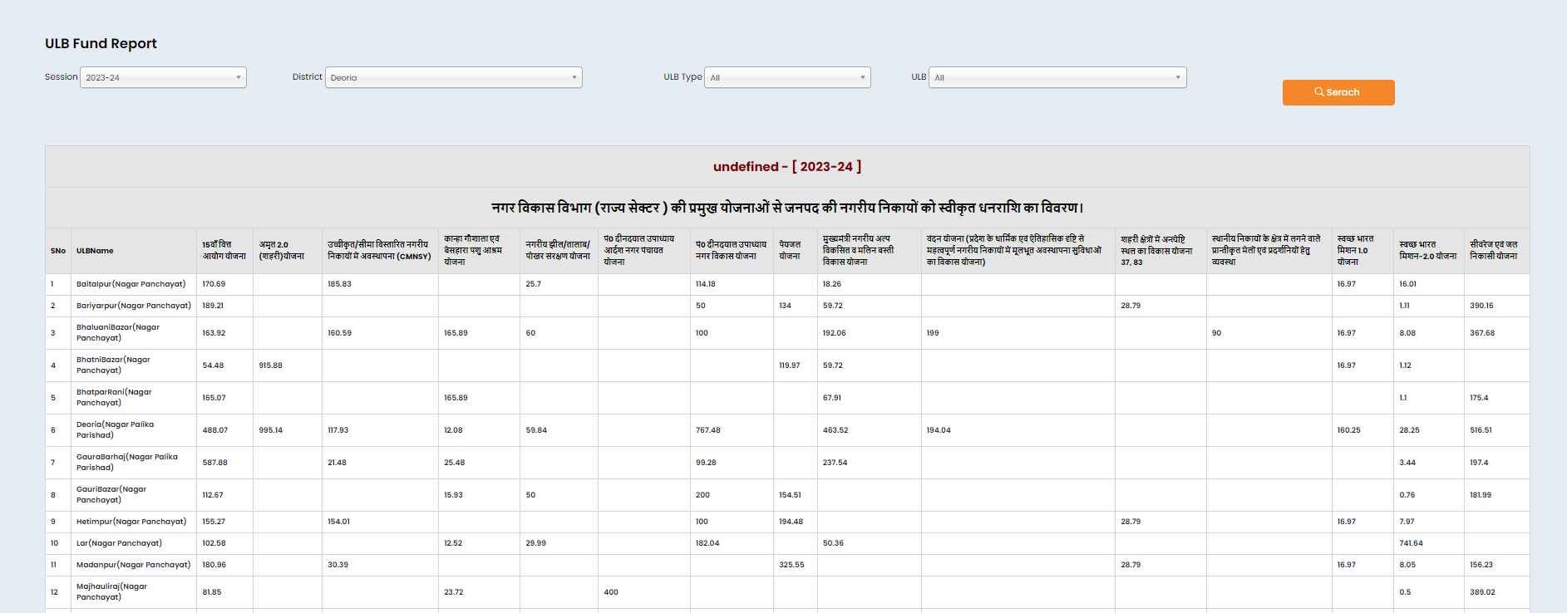
Similar as above for ULB fund master ,which include total sum rows and column wise ,Also include Export to Excel options and Heading Contains District Name
GIVE DISTRICT NAME WITH FY AS PER FILTER

Slide 4
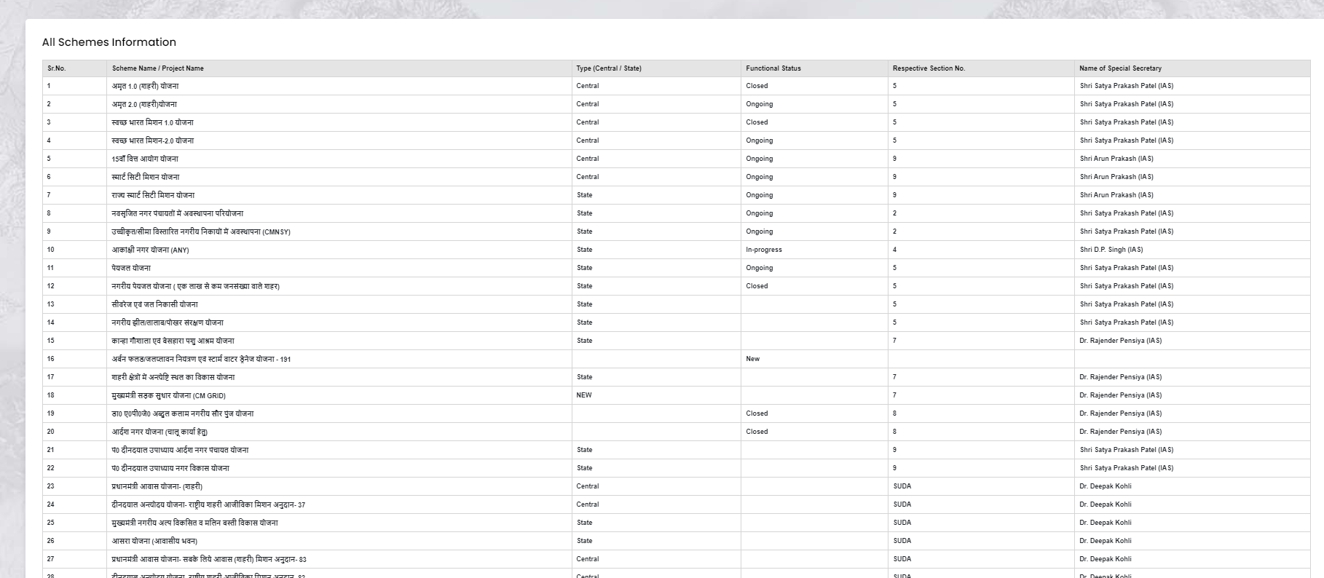
GIVE OPTION TO UPDATE THIS INFORMATION AT ADMIN LOGIN

